Slide 1
Chapter 11
ONE-WAY REPEATED MEASURES ANOVA

Slide 2
Hypothetical Data
X₁ | X₂ | X₃
57 | 60 | 64
71 | 72 | 74
75 | 76 | 78
93 | 92 | 96
M = 74
M = 75
M = 78

Slide 3
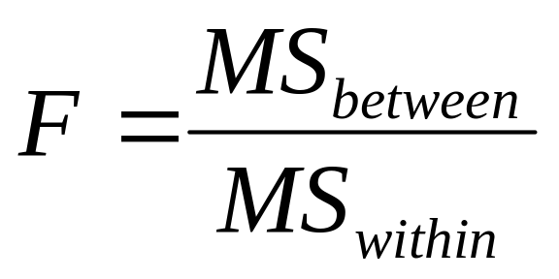
What do you predict?
X₁ | X₂ | X₃
57 | 60 | 64
71 | 72 | 74
75 | 76 | 78
93 | 92 | 96
M = 74
M = 75
M = 78

Slide 4
Same participants?
X₁ | X₂ | X₃
57 | 60 | 64
71 | 72 | 74
75 | 76 | 78
93 | 92 | 96
M = 74
M = 75
M = 78

Slide 5
One-way repeated-measures ANOVA
A hypothesis test used when you have
  one nominal IV with at least 3 levels
  a scale DV
  within-subject design (same people in each group)
Also called a one-way within-groups ANOVA

Slide 6
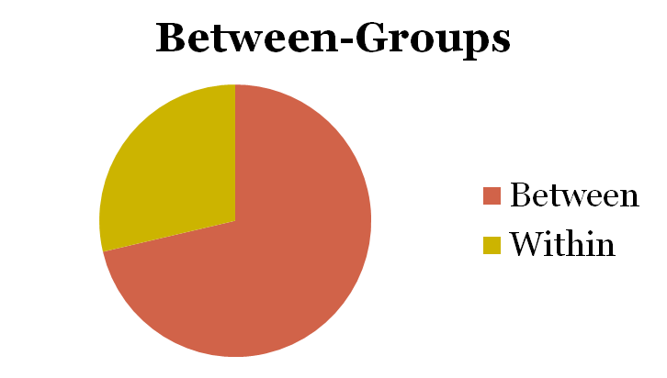
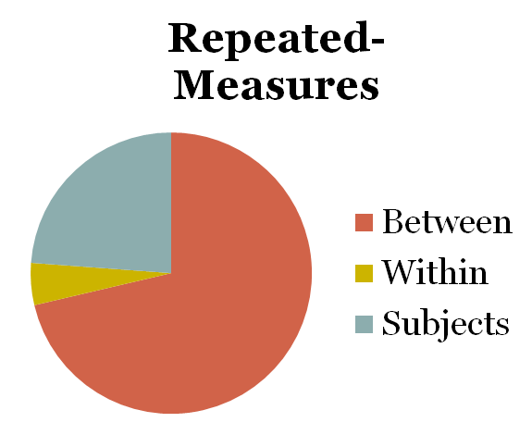
Partitioning of Variance

Slide 7
Assumptions
random selection of samples
normal distribution of DV in populations
homogeneity of variances
  samples come from populations with similar variances
control for order effects

Slide 8
Example
Many studies show that interspersing rest between practice sessions (spaced practice) produces better performance than a no-rest condition (massed practice).
Most studies use short rests (minutes or hours)
Bahrick et al. (1993) studied the effect of weeks of rest

Slide 9
Example
Thirteen practice sessions of learning the English equivalents of foreign words were interspersed with rest periods of 2, 4, or 8 weeks.
DV = percent recall on test
Subject | 2 wks | 4 wks | 8 wks
1 | 40 | 50 | 58
2 | 58 | 56 | 65
3 | 44 | 70 | 69
4 | 57 | 61 | 74

Slide 10
Step 1: Identify
Populations
  Population 1 = individuals given 2-wk rest intervals
  Population 2 = individuals given 4-wk rest intervals
  Population 3 = individuals given 8-wk rest intervals
Comparison distribution
  F distribution
Hypothesis test
  one-way repeated-measures ANOVA
Assumptions
  subjects not randomly selected
  do not know if populations are normally distributed
  we’ll check variances for homoscedasticity
  experimenter used counterbalancing

Slide 11
Step 2: H₀ & H₁
H₀ : No differences between population means
  H₀ : μ₁ = μ₂ = μ₃
H₁ : At least one population mean is different from at least one other population mean

Slide 12
Step 3: Identify the Sampling Distribution
df_{bwn} = N_{groups} – 1 = 3 – 1 = 2
df_{subjects} = n – 1 = 4 – 1 = 3
df_{within} = (df_{bwn})(df_{subjects}) = (2)(3) = 6
df_{total} = 11

Slide 13
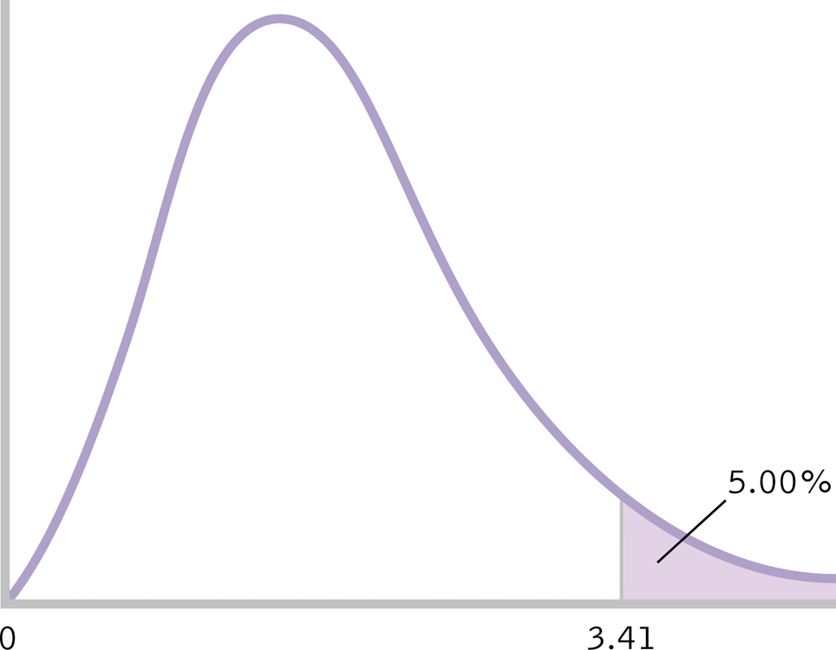
Step 4: Determine Critical Value
critical F = 5.14
5.14

Slide 14
Step 5: Calculate F
Calculate total sum of squares (SS_{total})
SS_{total} = ∑(X – GM)² = 1165

Slide 15
Step 5: Calculate F
Calculate between-groups sum of squares (SS_{between})
SS_{between} = ∑(M – GM)² = 564.48

Slide 16
Step 5: Calculate F
Calculate subjects sum of squares (SS_{subjects})
SS_{subjects} = ∑(M_{participant} – GM)² =367.53

Slide 17
Step 5: Calculate F
Calculate within-groups sum of squares (SS_{within})
SS_{within} = SS_{total} – SS_{between} – SS_{subjects}
SS_{within} = 1165 – 564.48 – 367.53 = 232.99

Slide 18
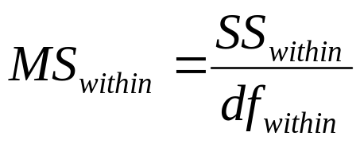
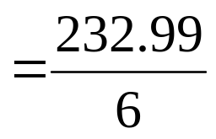

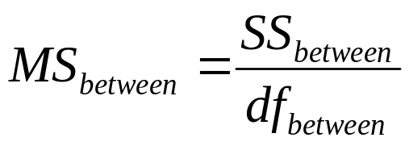
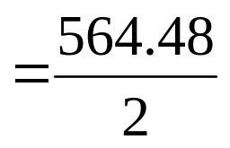

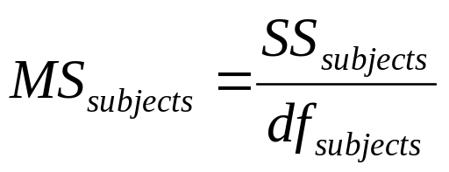
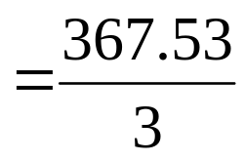

Step 5: Calculate F

Slide 19
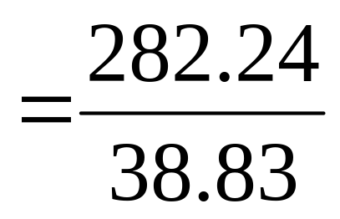
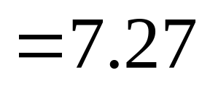
Step 5: Calculate F

Slide 20


Step 6: Make a Decision
Check to make sure we met assumption of equal variances
Is calculated F in critical region of sampling distribution?
7.27

Slide 21
Step 6: Make a Decision
Reject H₀
The three samples do not come from identical populations.
Length of rest period had a significant effect on memory performance, F(2,6)=7.27, p < .05

Slide 22
Source Table
Source | SS | df | MS | F
Between-gps | 564.48 | 2 | 282.24 | 7.27
Subjects | 367.53 | 3 | 122.51
Within-groups | 232.99 | 6 | 38.83
Total | 1165 | 11

Slide 23
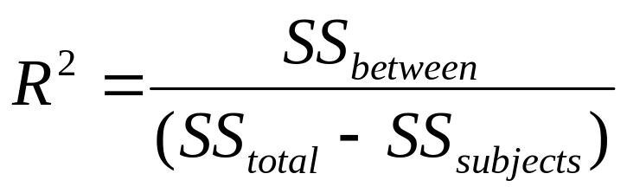
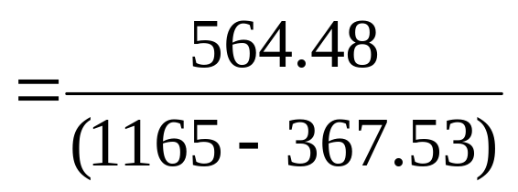

Effect Size
; large

Slide 24
Effect Size
R²
Proportion of variance in the DV that is accounted for by the IV
71% of the variability in memory performance is due to the length of the rest period.

Slide 25
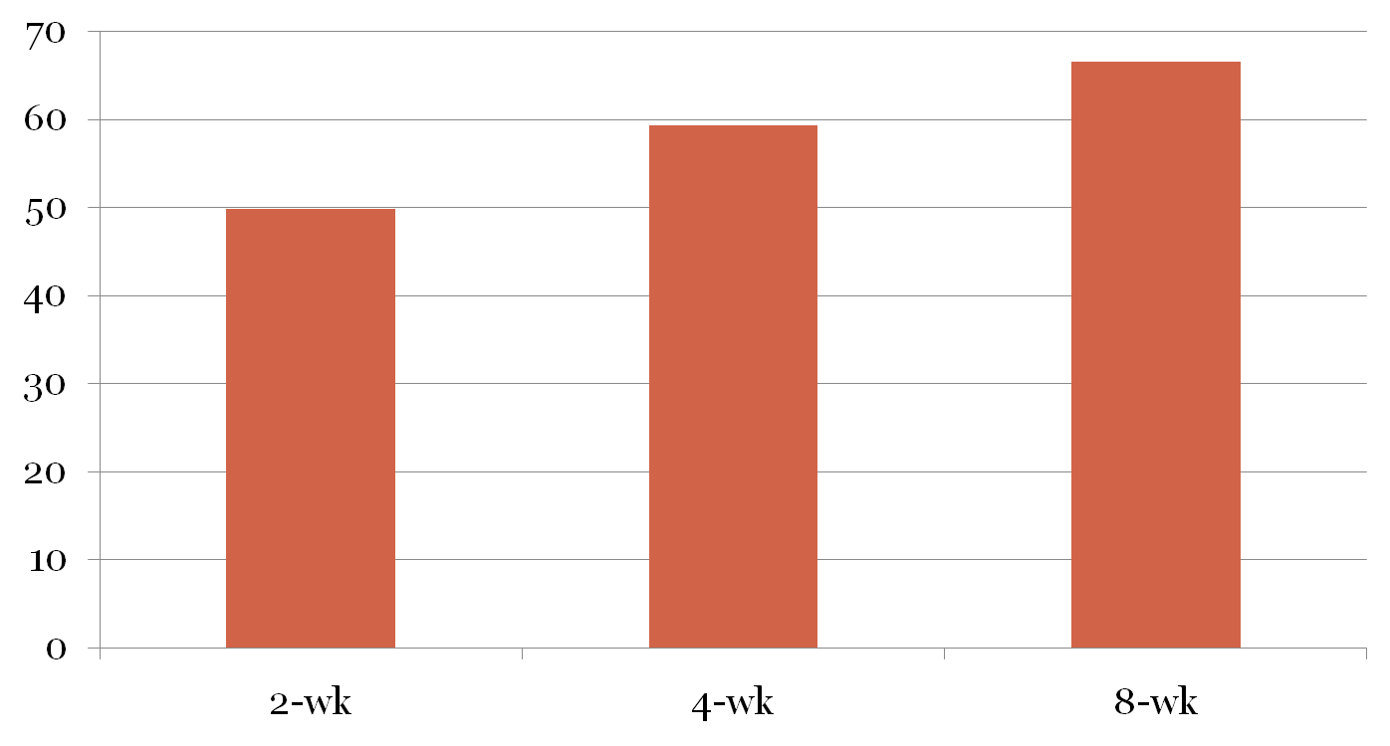
Multiple-Comparison Tests

Slide 26
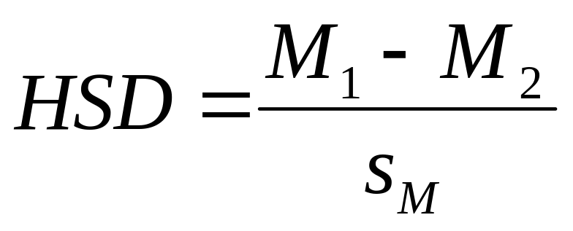
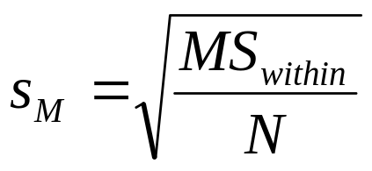
Tukey HSD
When N is same for all groups,

Slide 27
Summary Statement
Length of rest period has a statistically significant effect on percent recall, F(2,6)= 7.27, p<.05. The size of the effect is large, R²=.71. More specifically, a rest period of 8 weeks produced a significantly higher percent recall on test than a rest period of 2 weeks, HSD(3,6)=-5.37, p<.05.

